Slide 2
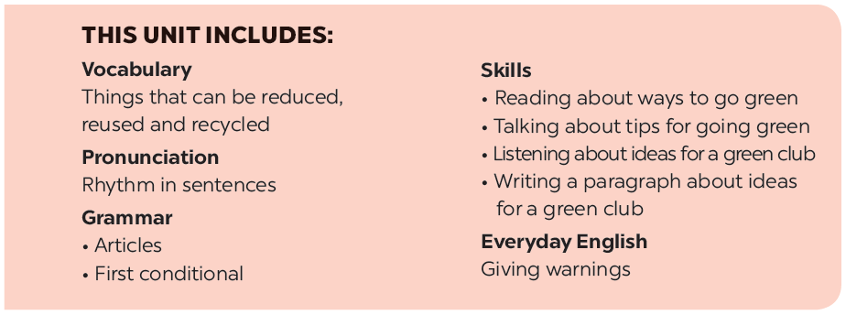

Slide 3
Vocabulary
Pronunciation
The three Rs stand for Reduce – Reuse – Recycle. Draw a line from a symbol in column A to its matching word in column B and its meaning in column C.
Rhythm in sentences
Listen to these sentences, then repeat. Pay attention to the bold syllables.
Write a word / phrase in the box under each picture.
Listen to the conversation. Pay attention to the bold syllables. Then practise the conversation with a classmate.
Work in pairs. Put the words from 2 into groups. Some words can belong to more than one group.

Slide 4
Vocabulary

Slide 5
The three Rs stand for Reduce – Reuse – Recycle. Draw a line from a symbol in column A to its matching word in column B and its meaning in column C.
A | B | C
 | Reduce | using something again
 | Reuse | creating new products from used materials
 | Recycle | using less of something

Slide 6
The three Rs stand for Reduce – Reuse – Recycle. Draw a line from a symbol in column A to its matching word in column B and its meaning in column C.
A | B | C
 | Reuse | using something again
 | Reduce | using less of something
 | Recycle | creating new products from used materials

Slide 7
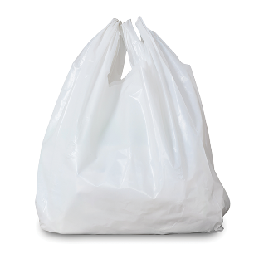
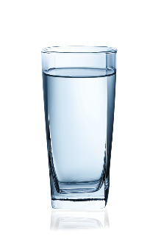
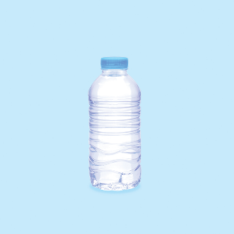
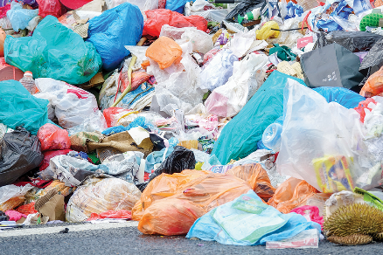
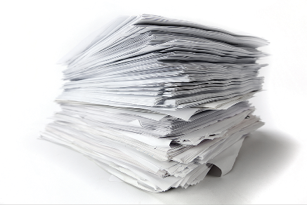
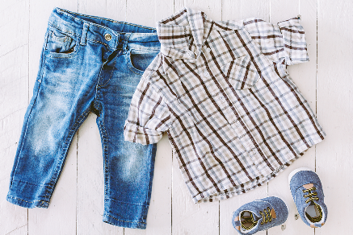
Write a word / phrase in the box under each picture.
rubbish
plastic bottle
glass
noise
plastic bag
paper
water
clothes

Slide 8
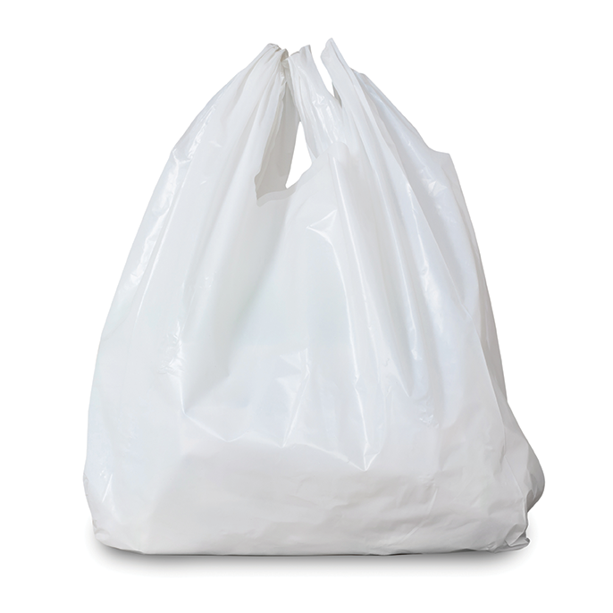
rubbish
plastic bottle
glass
noise
plastic bag
paper
water
clothes
1.
1. rubbish
2.
2. plastic bag

Slide 9
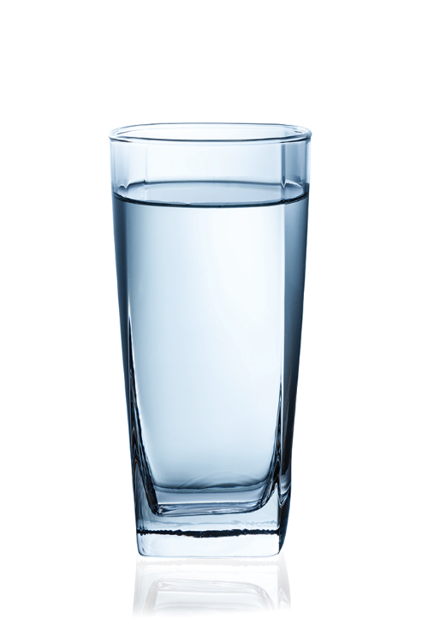
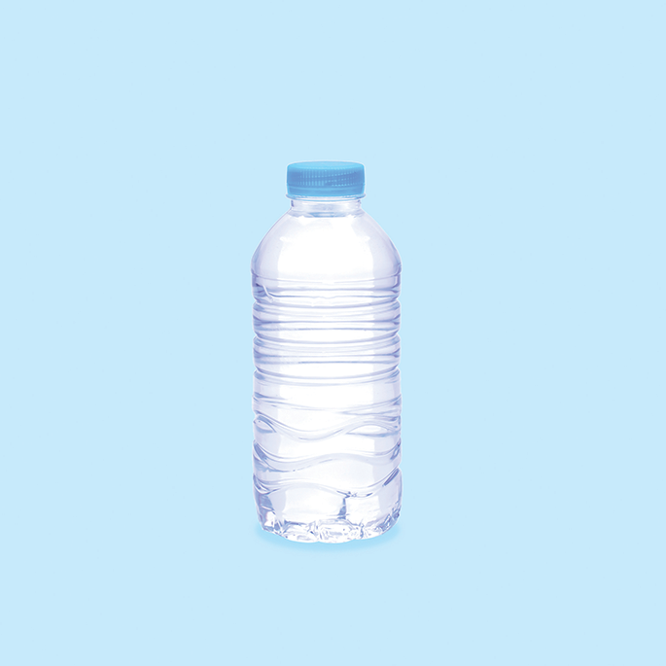
rubbish
plastic bottle
glass
noise
plastic bag
paper
water
clothes
3.
3. glass
4.
4. plastic bottle

Slide 10
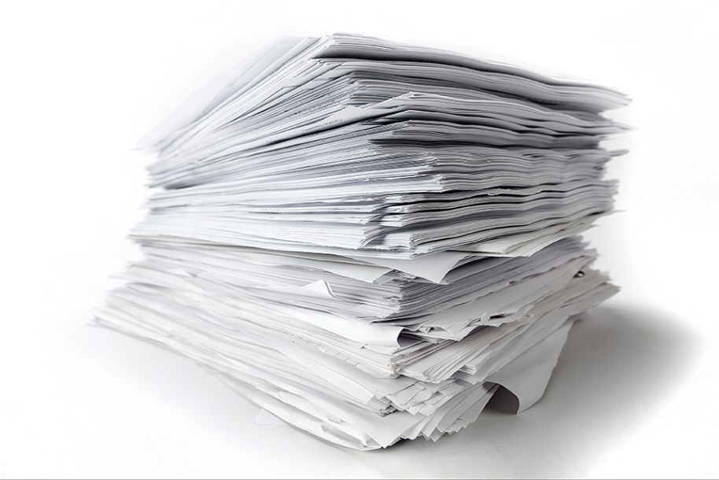
rubbish
plastic bottle
glass
noise
plastic bag
paper
water
clothes
5.
5. noise
6.
6. paper

Slide 11
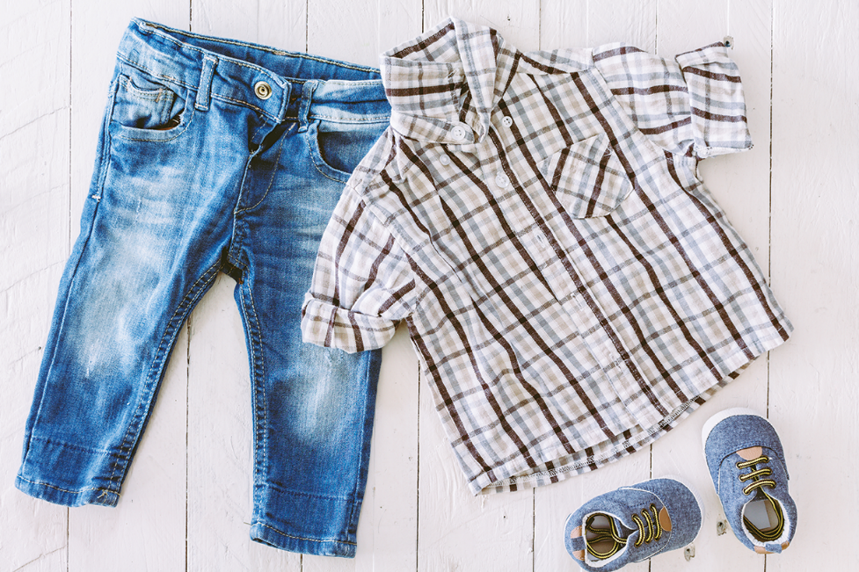
rubbish
plastic bottle
glass
noise
plastic bag
paper
water
clothes
7.
7. water
8.
8. clothes

Slide 12
Work in pairs. Put the words from 2 into groups. Some words can belong to more than one group.
Reduce | Reuse | Recycle

Slide 13
rubbish
plastic bottle
glass
noise
plastic bag
paper
water
clothes
Reduce | Reuse | Recycle
rubbish
plastic bag
rubbish
plastic bag
glass
plastic bag
noise
plastic bottle
glass
plastic bottle
paper
plastic bottle
paper
water
paper
water
clothes

Slide 14
Work in pairs. Put the words from 2 into groups. Some words can belong to more than one group.
Reduce | Reuse | Recycle
rubbish
plastic bag
rubbish
plastic bag
glass
plastic bag
noise
plastic bottle
glass
plastic bottle
paper
plastic bottle
paper
water
paper
water
clothes
Can you add more words to each group?

Slide 15
Pronunciation
Rhythm in sentences
In a sentence, the stressed and unstressed syllables combine to make rhythm.

Slide 16
Listen to these sentences, then repeat.
Pay attention to the bold syllables.
1.
If you cycle, it’ll help the Earth.
2.
Water is good for your body.
3.
The students are planting trees in the garden.
4.
Is it better to use paper bags?
5.
We are happy to walk to school.

Slide 17
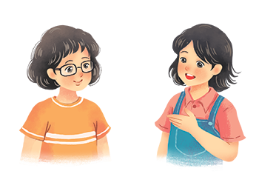
Listen to the conversation. Pay attention to the bold syllables. Then practise the conversation with a classmate.
Vy: What are you doing?
Mi: I’m writing an article about going green.
Vy: Great! I’m writing a poem about the 3Rs.
Mi: Let me read it.
Vy: I’m still writing. Wait for a minute.

